Slide 1
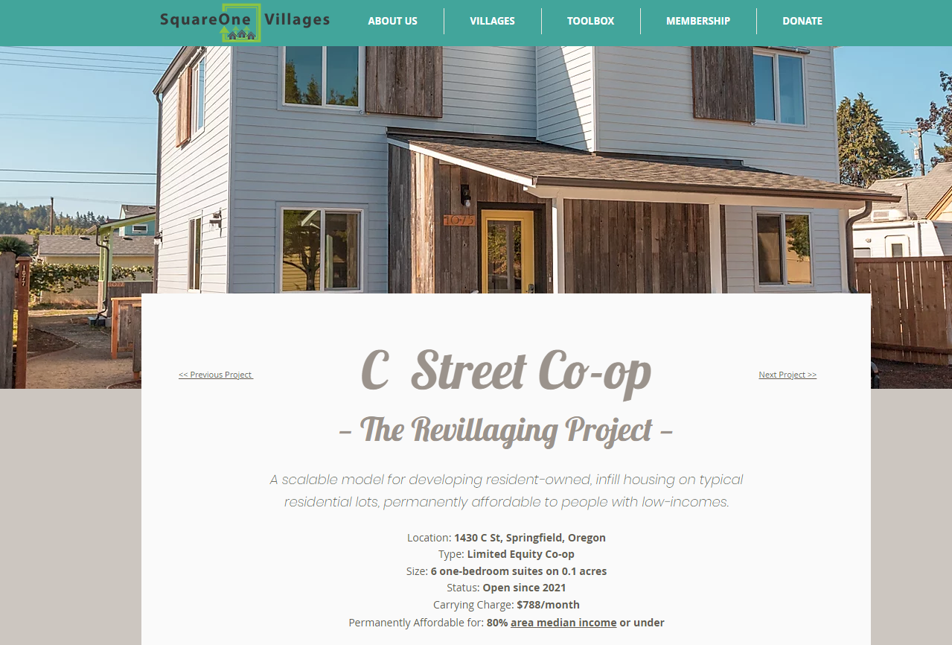

Slide 2
https://www.squareonevillages.org/c-street

